Slide 1
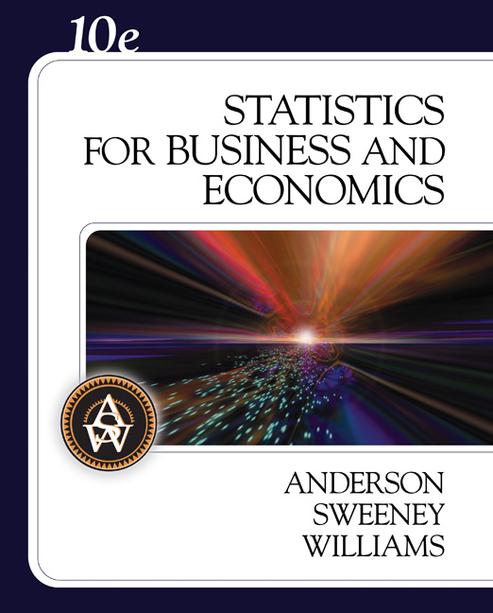
Slides by
JOHN
LOUCKS
& Updated by
SPIROS VELIANITIS

Slide 2
Chapter 15
Multiple Regression
Multiple Regression Model
Least Squares Method
Multiple Coefficient of Determination
Model Assumptions
Testing for Significance
Using the Estimated Regression Equation
for Estimation and Prediction
Qualitative Independent Variables
Residual Analysis
Logistic Regression

Slide 3
Multiple Regression Model
Multiple Regression Model
The equation that describes how the dependent variable y is related to the independent variables x₁, x₂, . . . x_{p} and an error term is:
y = β₀ + β₁x₁ + β₂x₂ + . . . + β_{p}x_{p} + ε
where:
β₀, β₁, β₂, . . . , β_{p} are the parameters, and
ε is a random variable called the error term

Slide 4
Multiple Regression Equation
Multiple Regression Equation
The equation that describes how the mean value of y is related to x₁, x₂, . . . x_{p} is:
E(y) = β₀ + β₁x₁ + β₂x₂ + . . . + β_{p}x_{p}

Slide 5
Estimated Multiple Regression Equation
Estimated Multiple Regression Equation
^
y = b₀ + b₁x₁ + b₂x₂ + . . . + b_{p}x_{p}
A simple random sample is used to compute sample statistics b₀, b₁, b₂, . . . , b_{p} that are used as the point estimators of the parameters β₀, β₁, β₂, . . . , β_{p}.

Slide 6
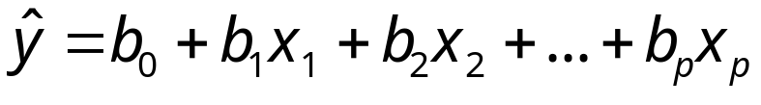
Estimation Process
Multiple Regression Model
E(y) = β₀ + β₁x₁ + β₂x₂ +. . .+ β_{p}x_{p} + ε
Multiple Regression Equation
E(y) = β₀ + β₁x₁ + β₂x₂ +. . .+ β_{p}x_{p}
Unknown parameters are
β₀, β₁, β₂, . . . , β_{p}
Sample Data:
x₁ x₂ . . . x_{p} y
. . . .
. . . .
Estimated Multiple
Regression Equation
Sample statistics are
b₀, b₁, b₂, . . . , b_{p}
b₀, b₁, b₂, . . . , b_{p}
provide estimates of
β₀, β₁, β₂, . . . , β_{p}

Slide 7

Least Squares Method
Least Squares Criterion
Computation of Coefficient Values
The formulas for the regression coefficients
b₀, b₁, b₂, . . . b_{p} involve the use of matrix algebra.
We will rely on computer software packages to
perform the calculations.

Slide 8
Multiple Regression Model
Example: Programmer Salary Survey
A software firm collected data for a sample
of 20 computer programmers. A suggestion
was made that regression analysis could
be used to determine if salary was related
to the years of experience and the score
on the firm’s programmer aptitude test.
The years of experience, score on the aptitude
test, and corresponding annual salary ($1000s) for a
sample of 20 programmers is shown on the next
slide.

Slide 9
Multiple Regression Model
Exper.
Score
Salary
Exper.
Score
Salary
4
7
1
5
8
10
0
1
6
6
78
100
86
82
86
84
75
80
83
91
24.0
43.0
23.7
34.3
35.8
38.0
22.2
23.1
30.0
33.0
9
2
10
5
6
8
4
6
3
3
88
73
75
81
74
87
79
94
70
89
38.0
26.6
36.2
31.6
29.0
34.0
30.1
33.9
28.2
30.0

Slide 10
Multiple Regression Model
Suppose we believe that salary (y) is
related to the years of experience (x₁) and the score on
the programmer aptitude test (x₂) by the following
regression model:
y = β₀ + β₁x₁ + β₂x₂ + ε
where
y = annual salary ($1000)
x₁ = years of experience
x₂ = score on programmer aptitude test

Slide 11
Solving for the Estimates of β₀, β₁, β₂
Least Squares
Output
Input Data
x₁ x₂ y
4 78 24
7 100 43
. . .
. . .
3 89 30
Computer
Package
for Solving
Multiple
Regression
Problems
b₀ =
b₁ =
b₂ =
R² =
etc.

Slide 12
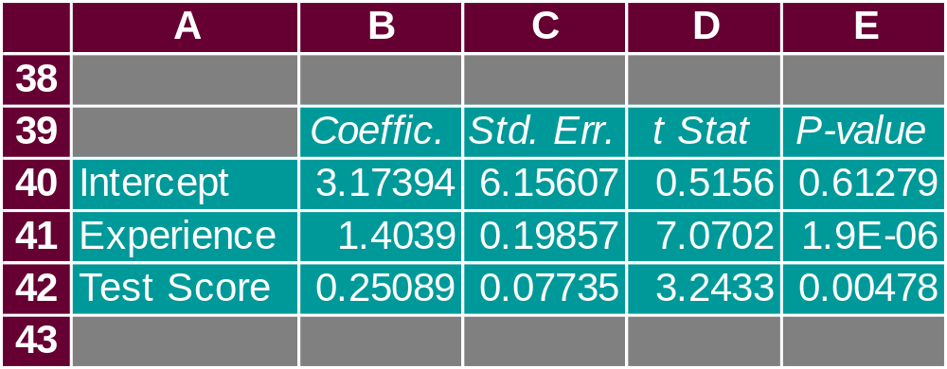
Solving for the Estimates of β₀, β₁, β₂
Excel’s Regression Equation Output
Note: Columns F-I are not shown.

Slide 13
Estimated Regression Equation
SALARY = 3.174 + 1.404(EXPER) + 0.251(SCORE)
Note: Predicted salary will be in thousands of dollars.

Slide 14
Interpreting the Coefficients
In multiple regression analysis, we interpret each
regression coefficient as follows:
b_{i} represents an estimate of the change in y
corresponding to a 1-unit increase in x_{i} when all
other independent variables are held constant.

Slide 15
Interpreting the Coefficients
b₁ = 1.404
Salary is expected to increase by $1,404 for
each additional year of experience (when the variable
score on programmer attitude test is held constant).

Slide 16
Interpreting the Coefficients
b₂ = 0.251
Salary is expected to increase by $251 for each
additional point scored on the programmer aptitude
test (when the variable years of experience is held
constant).

Slide 17



Multiple Coefficient of Determination
Relationship Among SST, SSR, SSE
SST = SSR + SSE
=
+
where:
SST = total sum of squares
SSR = sum of squares due to regression
SSE = sum of squares due to error

Slide 18
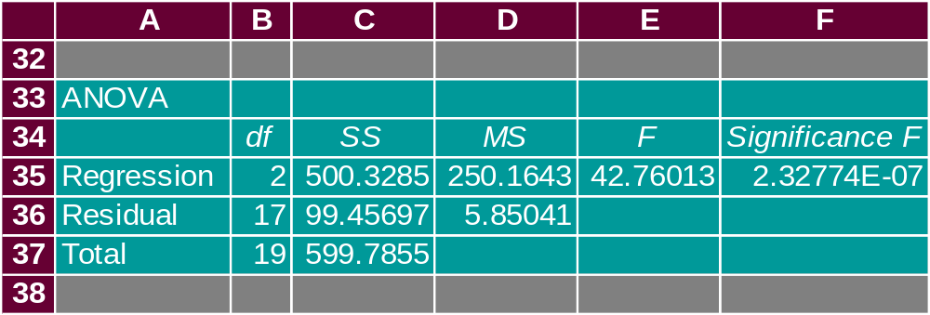
Multiple Coefficient of Determination
Excel’s ANOVA Output
SSR
SST

Slide 19
Multiple Coefficient of Determination
R² = SSR/SST
R² = 500.3285/599.7855 = .83418

Slide 20
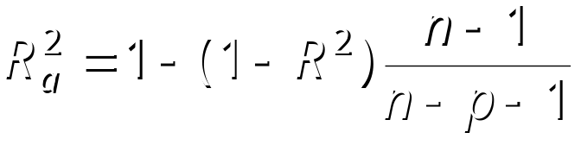
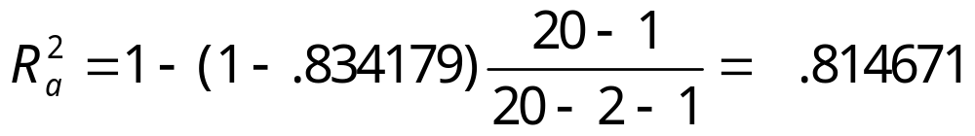
Adjusted Multiple Coefficient
of Determination

Slide 21
Assumptions About the Error Term ε
The error ε is a random variable with mean of zero.
The variance of ε , denoted by σ ², is the same for all
values of the independent variables.
The values of ε are independent.
The error ε is a normally distributed random variable
reflecting the deviation between the y value and the
expected value of y given by β₀ + β₁x₁ + β₂x₂ + . . + β_{p}x_{p}.

Slide 22
Testing for Significance
In simple linear regression, the F and t tests provide
the same conclusion.
In multiple regression, the F and t tests have different
purposes.

Slide 23
Testing for Significance: F Test
The F test is used to determine whether a significant
relationship exists between the dependent variable
and the set of all the independent variables.
The F test is referred to as the test for overall
significance.

Slide 24
Testing for Significance: t Test
If the F test shows an overall significance, the t test is
used to determine whether each of the individual
independent variables is significant.
A separate t test is conducted for each of the
independent variables in the model.
We refer to each of these t tests as a test for individual
significance.

Slide 25
Testing for Significance: F Test
Hypotheses
H₀: β₁ = β₂ = . . . = β_{p} = 0
H_{a}: One or more of the parameters
is not equal to zero.
Test Statistics
F = MSR/MSE
Rejection Rule
Reject H₀ if p-value < α or if F > F_{α},
where F_{α} is based on an F distribution
with p d.f. in the numerator and
n - p - 1 d.f. in the denominator.

Slide 26


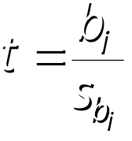
Testing for Significance: t Test
Hypotheses
Test Statistics
Rejection Rule
Reject H₀ if p-value < α or
if t < -t_{α/2} or t > t_{α/2} where t_{α/2}
is based on a t distribution
with n - p - 1 degrees of freedom.

Slide 27
Testing for Significance: Multicollinearity
The term multicollinearity refers to the correlation
among the independent variables.
When the independent variables are highly correlated
(say, |r | > .7), it is not possible to determine the
separate effect of any particular independent variable
on the dependent variable.

Slide 28
Testing for Significance: Multicollinearity
If the estimated regression equation is to be used only
for predictive purposes, multicollinearity is usually
not a serious problem.
Every attempt should be made to avoid including
independent variables that are highly correlated.

Slide 29
Using the Estimated Regression Equation
for Estimation and Prediction
The procedures for estimating the mean value of y
and predicting an individual value of y in multiple
regression are similar to those in simple regression.
We substitute the given values of x₁, x₂, . . . , x_{p} into
the estimated regression equation and use the
corresponding value of y as the point estimate.

Slide 30
Using the Estimated Regression Equation
for Estimation and Prediction
The formulas required to develop interval estimates
for the mean value of y and for an individual value
of y are beyond the scope of the textbook.
^
Software packages for multiple regression will often
provide these interval estimates.

Slide 31
Qualitative Independent Variables
In many situations we must work with qualitative
independent variables such as gender (male, female),
method of payment (cash, check, credit card), etc.
For example, x₂ might represent gender where x₂ = 0
indicates male and x₂ = 1 indicates female.
In this case, x₂ is called a dummy or indicator variable.

Slide 32
Qualitative Independent Variables
Example: Programmer Salary Survey
As an extension of the problem involving the
computer programmer salary survey, suppose
that management also believes that the
annual salary is related to whether the
individual has a graduate degree in
computer science or information systems.
The years of experience, the score on the programmer
aptitude test, whether the individual has a relevant
graduate degree, and the annual salary ($1000) for each
of the sampled 20 programmers are shown on the next
slide.

Slide 33
Qualitative Independent Variables
Exper.
Score
Degr.
Salary
Exper.
Score
Degr.
Salary
4
7
1
5
8
10
0
1
6
6
78
100
86
82
86
84
75
80
83
91
No
Yes
No
Yes
Yes
Yes
No
No
No
Yes
24.0
43.0
23.7
34.3
35.8
38.0
22.2
23.1
30.0
33.0
9
2
10
5
6
8
4
6
3
3
88
73
75
81
74
87
79
94
70
89
Yes
No
Yes
No
No
Yes
No
Yes
No
No
38.0
26.6
36.2
31.6
29.0
34.0
30.1
33.9
28.2
30.0

Slide 34
Estimated Regression Equation
y = b₀ + b₁x₁ + b₂x₂ + b₃x₃
where:
y = annual salary ($1000)
x₁ = years of experience
x₂ = score on programmer aptitude test
x₃ = 0 if individual does not have a graduate degree
1 if individual does have a graduate degree
^
x₃ is a dummy variable

Slide 35
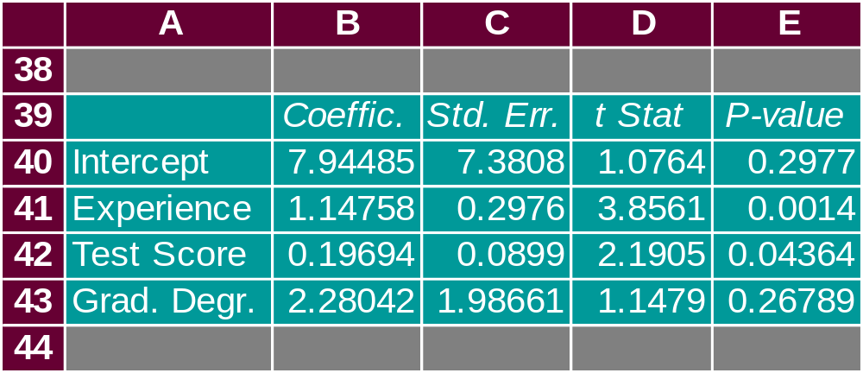
Qualitative Independent Variables
Excel’s Regression Equation Output
Note: Columns F-I are not shown.
Not significant

Slide 36
More Complex Qualitative Variables
If a qualitative variable has k levels, k - 1 dummy
variables are required, with each dummy variable
being coded as 0 or 1.
For example, a variable with levels A, B, and C could
be represented by x₁ and x₂ values of (0, 0) for A, (1, 0)
for B, and (0,1) for C.
Care must be taken in defining and interpreting the
dummy variables.

Slide 37
More Complex Qualitative Variables
For example, a variable indicating level of education could be represented by x₁ and x₂ values as follows:
Highest
Degree x₁ x₂
Bachelor’s 0 0
Master’s 1 0
Ph.D. 0 1

Slide 38

Residual Analysis
For simple linear regression the residual plot against
and the residual plot against x provide the same information.
In multiple regression analysis it is preferable to use the residual plot against to determine if the model assumptions are satisfied.

Slide 39

Standardized Residual Plot Against
Standardized residuals are frequently used in residual plots for purposes of:
  Identifying outliers (typically, standardized residuals < -2 or > +2)
  Providing insight about the assumption that the error term ε has a normal distribution
The computation of the standardized residuals in multiple regression analysis is too complex to be done by hand
Excel’s Regression tool can be used

Slide 40
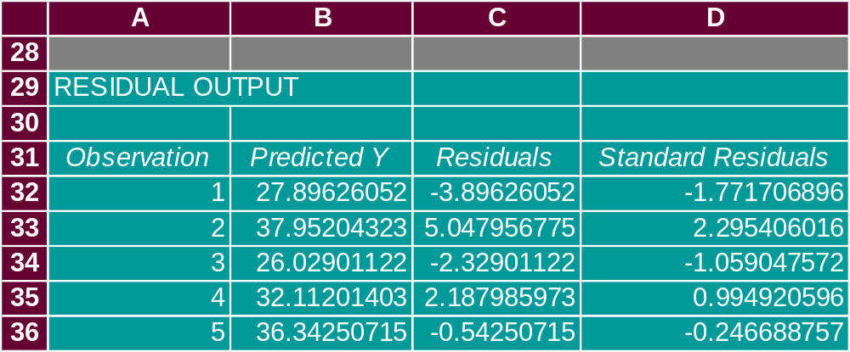
Standardized Residual Plot Against
Excel Value Worksheet
Note: Rows 37-51 are not shown.

Slide 41
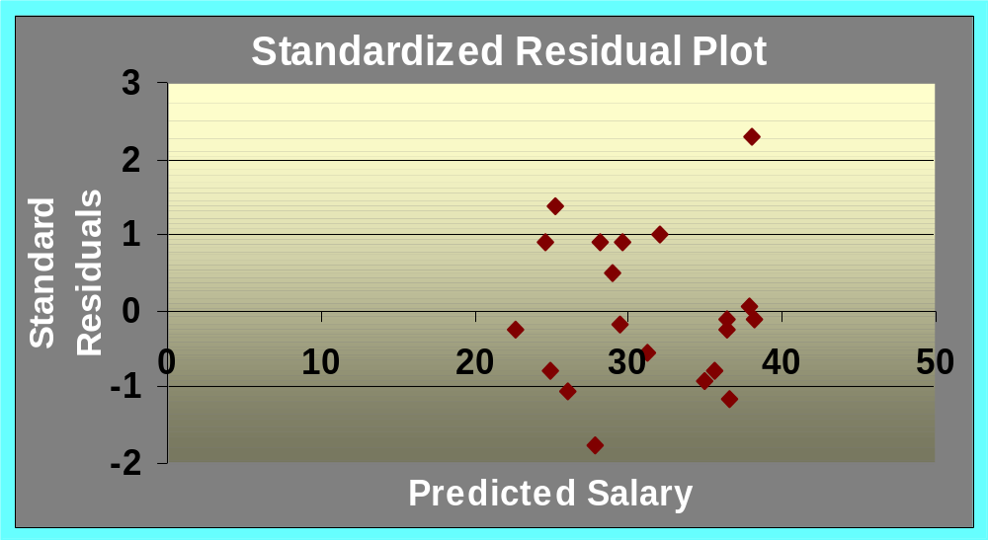
Standardized Residual Plot Against
Excel’s Standardized Residual Plot
Outlier

Slide 42
Logistic Regression
In many ways logistic regression is like ordinary regression. It requires a dependent variable, y, and one or more independent variables.
Logistic regression can be used to model situations in which the dependent variable, y, may only assume two discrete values, such as 0 and 1.
The ordinary multiple regression model is not applicable.

Slide 43
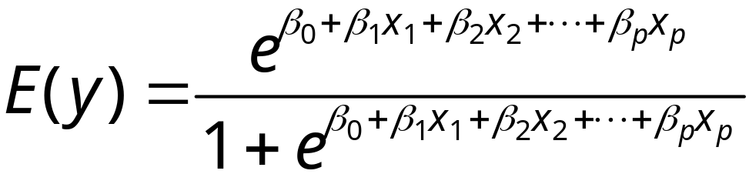
Logistic Regression
Logistic Regression Equation
The relationship between E(y) and x₁, x₂, . . . , x_{p} is
better described by the following nonlinear equation.

Slide 44
Logistic Regression
Interpretation of E(y) as a
Probability in Logistic Regression
If the two values of y are coded as 0 or 1, the value
of E(y) provides the probability that y = 1 given a
particular set of values for x₁, x₂, . . . , x_{p}.

Slide 45
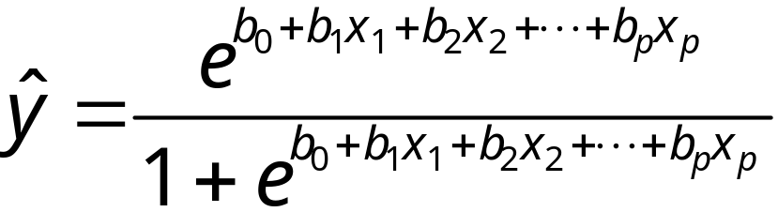
Logistic Regression
Estimated Logistic Regression Equation
A simple random sample is used to compute sample statistics b₀, b₁, b₂, . . . , b_{p} that are used as the point estimators of the parameters β₀, β₁, β₂, . . . , β_{p}.

Slide 46
Logistic Regression
Example: Simmons Stores
Simmons’ catalogs are expensive and Simmons
would like to send them to only those customers who
have the highest probability of making a $200 purchase
using the discount coupon included in the catalog.
Simmons’ management thinks that annual spending
at Simmons Stores and whether a customer has a
Simmons credit card are two variables that might be
helpful in predicting whether a customer who receives
the catalog will use the coupon to make a $200
purchase.

Slide 47
Logistic Regression
Example: Simmons Stores
Simmons conducted a study by sending out 100
catalogs, 50 to customers who have a Simmons credit
card and 50 to customers who do not have the card.
At the end of the test period, Simmons noted for each of
the 100 customers:
1) the amount the customer spent last year at Simmons,
2) whether the customer had a Simmons credit card, and
3) whether the customer made a $200 purchase.
A portion of the test data is shown on the next slide.

Slide 48
Logistic Regression
Simmons Test Data (partial)
x₁
x₂
y
Annual Spending
($1000)
2.291
3.215
2.135
3.924
2.528
2.473
2.384
7.076
1.182
3.345
Simmons
Credit Card
1
1
1
0
1
0
0
0
1
0
$200
Purchase
0
0
0
0
0
1
0
0
1
0
Customer
1
2
3
4
5
6
7
8
9
10

Slide 49
Logistic Regression
Simmons Logistic Regression Table (using Minitab)
Predictor
Coef
SE Coef
Z
p
Odds
Ratio
95% CI
Lower Upper
Constant
Spending
Card
-2.1464
0.3416
1.0987
0.5772
0.1287
0.4447
-3.72
2.66
2.47
0.000
0.008
0.013
1.41
3.00
1.09
1.25
1.81
7.17
Log-Likelihood = -60.487
Test that all slopes are zero: G = 13.628, DF = 2, P-Value = 0.001

Slide 50
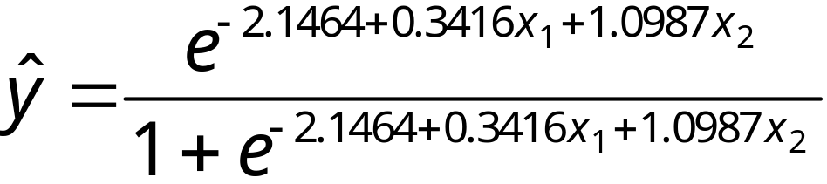
Logistic Regression
Simmons Estimated Logistic Regression Equation

Slide 51
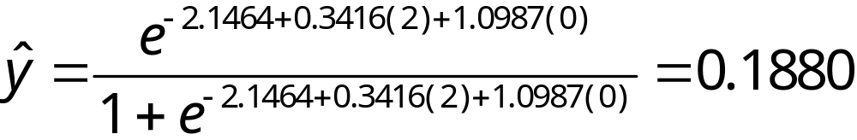
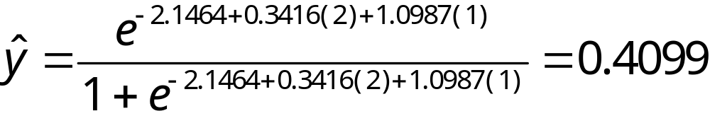
Logistic Regression
Using the Estimated Logistic Regression Equation
For customers that spend $2000 annually
and do not have a Simmons credit card:
For customers that spend $2000 annually
and do have a Simmons credit card:

Slide 52
Logistic Regression
Testing for Significance
Hypotheses
H₀: β₁ = β₂ = 0
H_{a}: One or both of the parameters
is not equal to zero.
Test Statistics
z = b_{i}/s_{bi}
Rejection Rule
Reject H₀ if p-value < α

Slide 53
Logistic Regression
Testing for Significance
Conclusions
For independent variable x₁:
z = 2.66 and the p-value = .008.
Hence, β₁ = 0. In other words,
x₁ is statistically significant.
For independent variable x₂:
z = 2.47 and the p-value = .013.
Hence, β₂ = 0. In other words,
x₂ is also statistically significant.

Slide 54
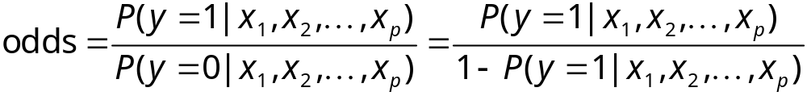
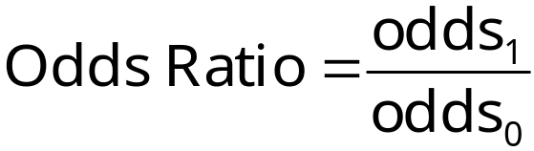
Logistic Regression
With logistic regression is difficult to interpret the relation-
ship between the variables because the equation is not linear so we use the concept called the odds ratio.
The odds in favor of an event occurring is defined as the
probability the event will occur divided by the probability
the event will not occur.
Odds in Favor of an Event Occurring
Odds Ratio

Slide 55
Logistic Regression
Estimated Probabilities
Annual Spending
$1000 $2000 $3000 $4000 $5000 $6000 $7000
Credit
Card
Yes
No
0.3305 0.4099 0.4943 0.5790 0.6593 0.7314 0.7931
0.1413 0.1880 0.2457 0.3143 0.3921 0.4758 0.5609
Computed
earlier

Slide 56
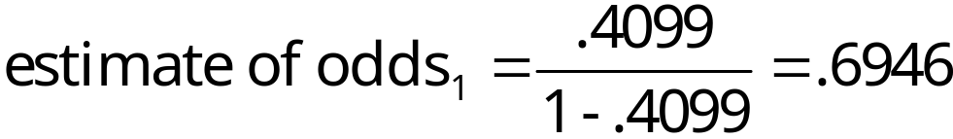
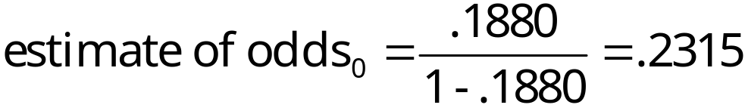
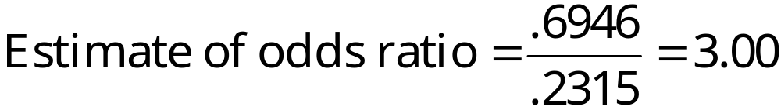
Logistic Regression
Comparing Odds
Suppose we want to compare the odds of making a
$200 purchase for customers who spend $2000 annually
and have a Simmons credit card to the odds of making a
$200 purchase for customers who spend $2000 annually
and do not have a Simmons credit card.

Slide 57
Chapter 15
Multiple Regression
Multiple Regression Model
Least Squares Method
Multiple Coefficient of Determination
Model Assumptions
Testing for Significance
Using the Estimated Regression Equation
for Estimation and Prediction
Qualitative Independent Variables
Residual Analysis
Logistic Regression

